Slide 1
Introduction
Experimental results
Overview of experiment
Lower energy results
High energy
TD-DFT calculations

Slide 2


Slide 3
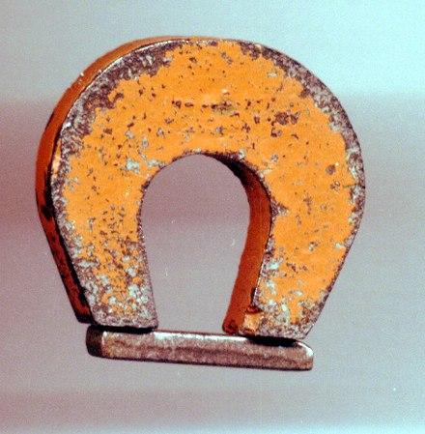
Magnetic Excitations in the Itinerant Electron Ferromagnet Iron Measured throughout the Brillouin Zone
Toby Perring Alex Buts
Martin Lueders
Herb Mook

Slide 4

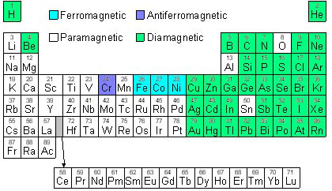
Motivation
Classic itinerant electron ferromagnets: Fe, Co, Ni
Correlated electron system
Benchmark for calculations of spin dynamics

Slide 5
Motivation
Benchmark for calculations of spin dynamics
Magnetism and its dynamics plays a central role in metallic systems with strong e⁻ - e⁻ correlations
Fluctuations mediate superconductivity in cuprates and iron pnictides
Role in QCP
Role in transport properties
Interplay with orbital, electronic and charge d.o.f. in manganites
Dynamical susceptibility at the heart of time-dependent response to external perturbations
Reliable prediction of dynamical susceptibility ➔ understanding in complex systems

Slide 6
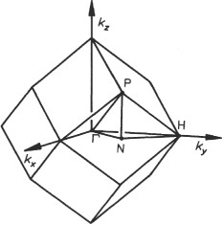
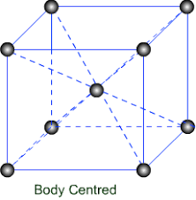
Iron
a = b = c = 2.845 Å
T_{C} = 1043 K
M = 2.2 μ_{B}

Slide 7
Itinerant magnetism in iron
M.F. Collins et al, Physical Review 179 417 (1968)

Slide 8
What do we expect?
energy
ε
wavevector
q
⇓
Single particle excitations
Collective excitations Magnons
Magnon damping

Slide 9
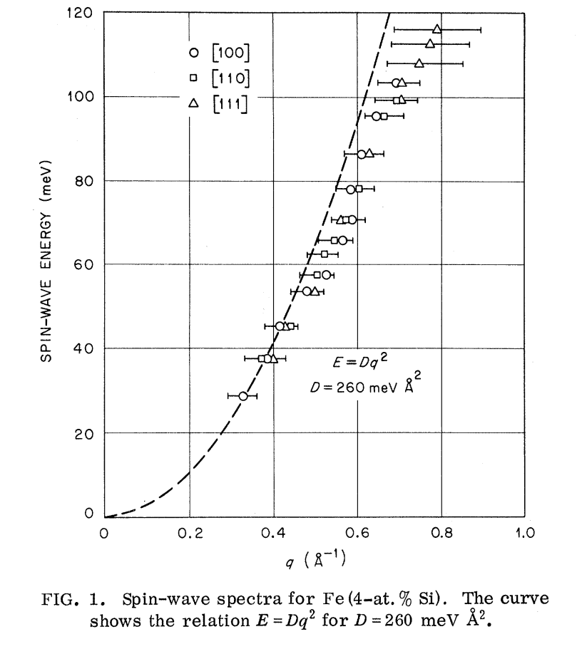
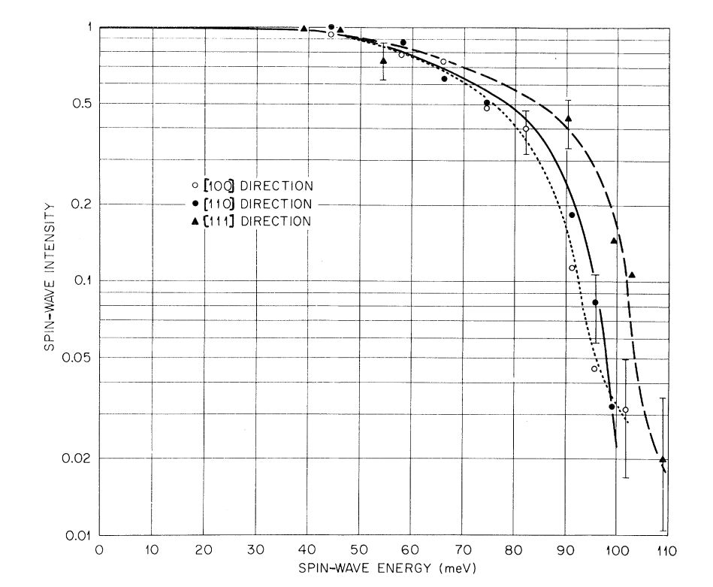
Earlier results pt.I: damping
Dispersion
Spin wave intensity
E = D q²
D = 260 meV Å²
H. A. Mook & R.M. Nicklow; PRB 7 336 1973 (⁵⁴Fe+4at%Si)

Slide 10
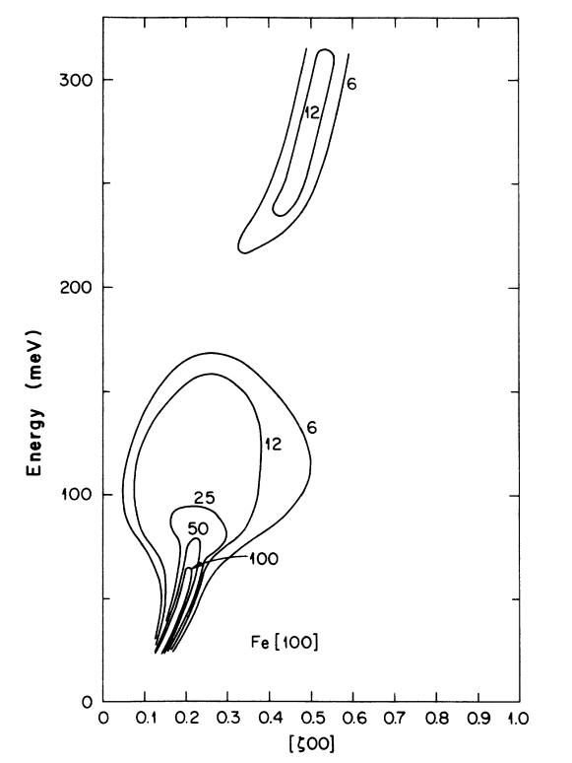
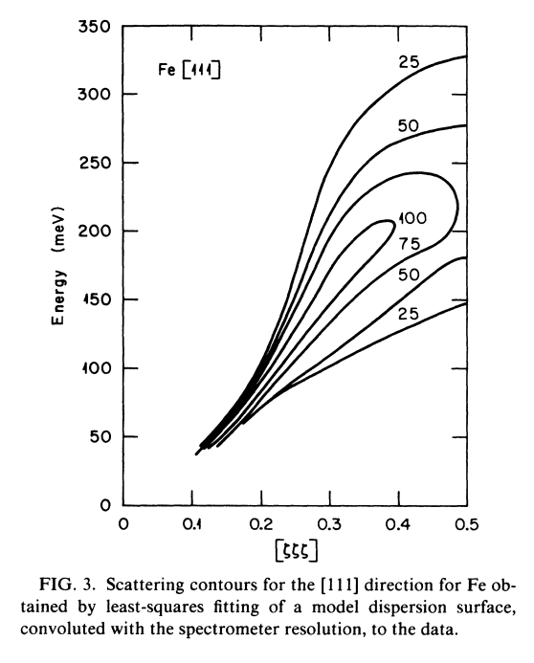
Earlier results pt.II: high energy sprectum
[100]
[111]
Triple axis spectrometer:
D. McKenzie Paul et al., PRB 38 580 (1988)
TOF instrument:
C.K. Loong et al., J. Appl. Phys 55 1895 (1984)

Slide 11
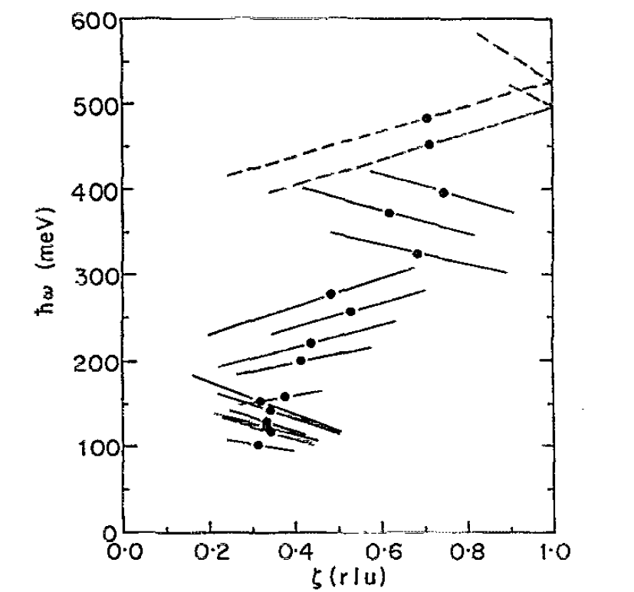
Earlier results pt.II: high energy sprectum
[100]
[111]
[100]
Triple axis spectrometer:
D. McKenzie Paul et al., PRB 38 580 (1988)
TOF instrument:
T. G. Perring et al., J. Appl. Phys 69 3219 (1991)

Slide 12
Earlier results pt.II: high energy sprectum
RPA calculations
[100]
[111]
[100]
Triple axis spectrometer:
D. McKenzie Paul et al., PRB 38 580 (1988)
J.A. Blackman et al PRL 55 2814 (1985)
Developments in calculation approaches
Development in instrumentation

Slide 13
Introduction
Experimental results
Overview of experiment
Lower energy results
High energy
TD-DFT calculations

Slide 14
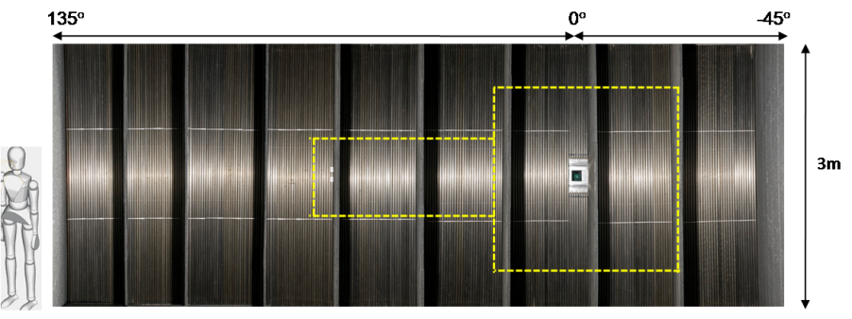
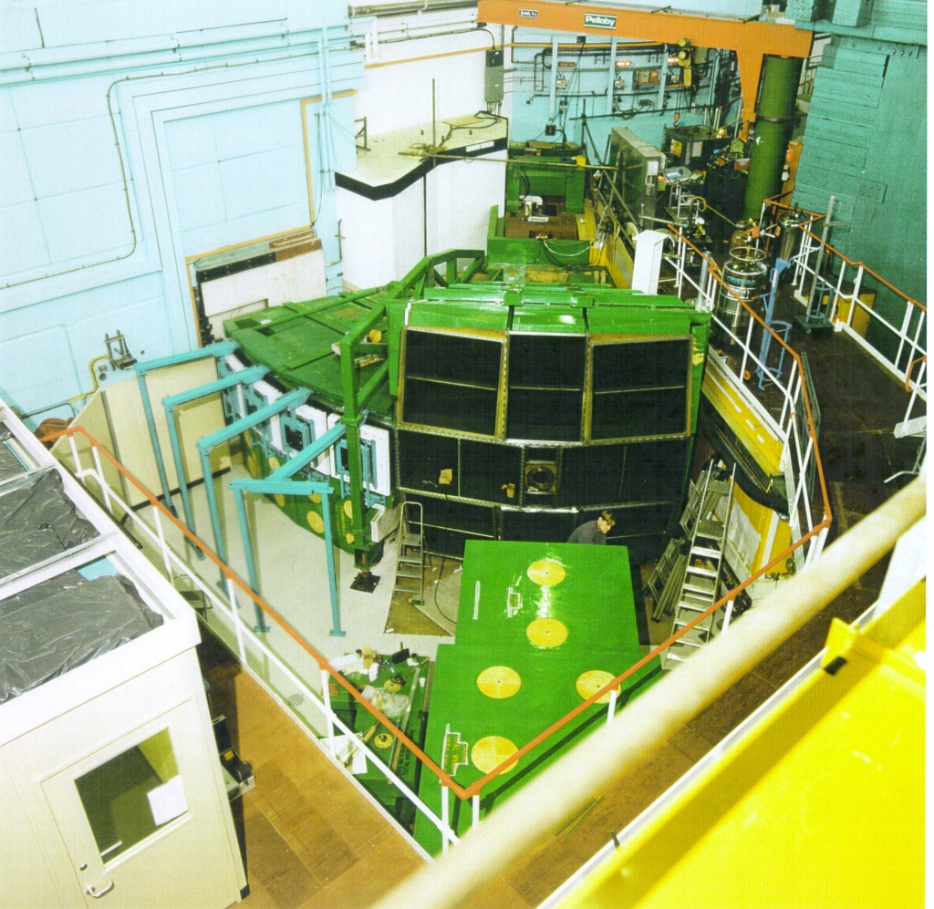
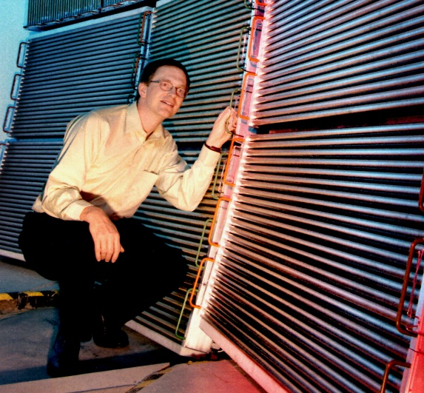
Measuring Excitations – Time-of-flight
3 degrees of freedom:
(φ,θ,t) → (Q_{x}, Q_{y}, ε)
MAPS spectrometer
4 degrees of freedom: crystal angle:
- (φ,θ,t, ψ) → (Q_{x}, Q_{y}, Q_{z}, ε)
2×10⁹ voxels

Slide 15

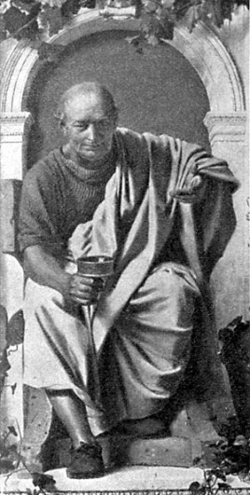
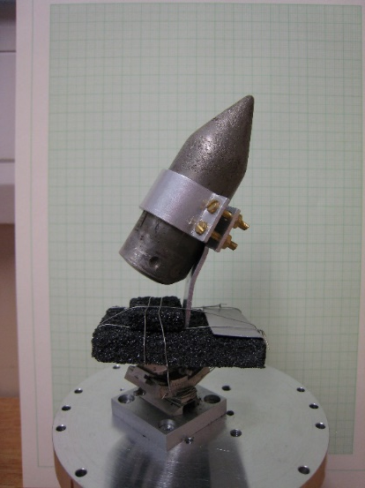
Experiment
MAPS spectrometer
Horace software
http://horace.isis.rl.ac.uk/Main_Page
+
+
Ei: _
100 meV
200 meV
401 meV
787 meV
1371 meV
≈ 4% ΔE/E energy resolution

Slide 16
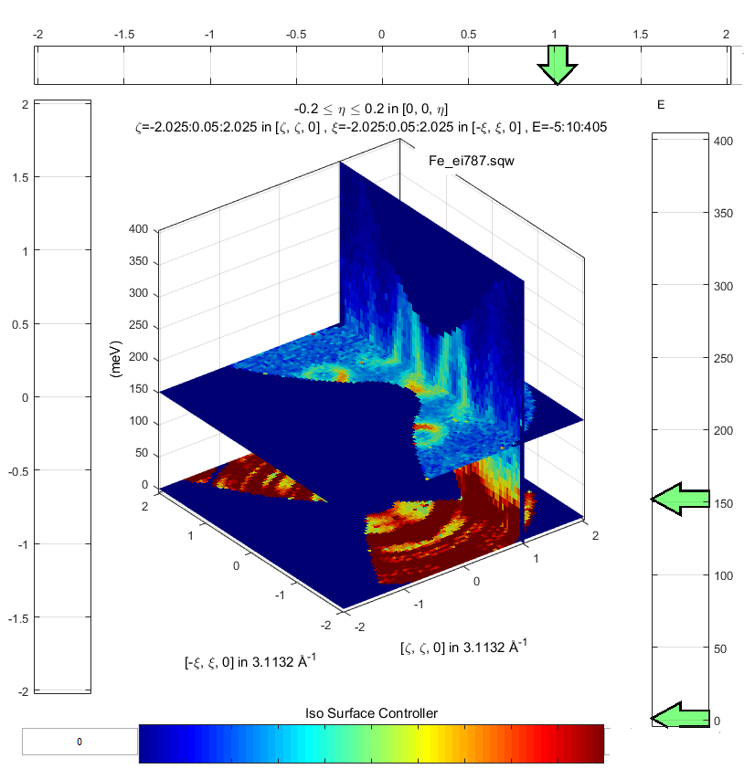
Experiment: data
Ei = 800 meV

Slide 17
Experiment: data
Ei = 787 meV

Slide 18
Ei = 400 meV
Ei = 200 meV

Slide 19
Experiment: data overview
[100]
[110]
[111]
No obvious fall-off in intensity as go through 100 meV
No dramatic broadening along [100] above c. 100 meV
No gap at c. 200 meV along [100]

Slide 20
Experiment: data at low energies
Energy scale: JS_{eff}
-- Ei 400 meV
-- Ei 200 meV
Heisenberg ferromagnet dispersion relation
Allow for damped simple harmonic oscillator inverse lifetime γ
Least-squares fit with full 4D resolution function convolution

Slide 21
Experiment: data at low energies
Energy scale: JS_{eff}
-- Ei 400 meV
-- Ei 200 meV
JSeff = 25 meV ➔ D = 205 meV Å²
260 meV Å²
205 meV Å²
H. A. Mook & R.M. Nicklow; PRB 7 336 1973 (⁵⁴Fe+4at%Si)
J.W. Lynn ; PRB 11 208 (1975) (⁵⁴Fe+10at%Si)

Slide 22
Ei = 200 meV
ε=50 meV
ε=70 meV
ε=90 meV
ε=110 meV

Slide 23
Experiment: data at low energies
Effective spin for intensity, S_{eff}
Effective spin S_{eff}
Energy transfer (meV)
H. A. Mook & R.M. Nicklow; PRB 7 336 1973

Slide 24
Experiment: data at low energies
Effective spin for intensity, S_{eff}
Effective spin S_{eff}
Energy transfer (meV)
Damping
Inverse lifetime (meV)
Energy transfer (meV)

Slide 25
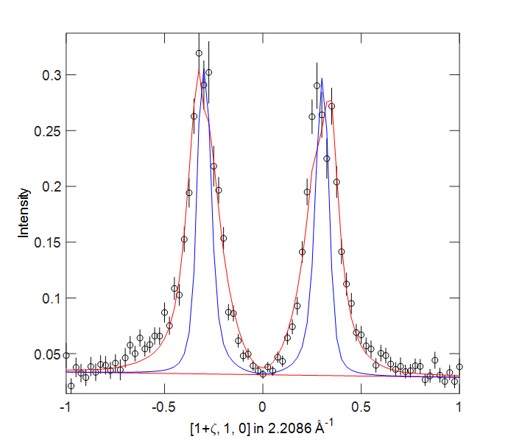
Experiment: data at low energies
Sensitivity to inverse lifetime:
ε=100 meV

Slide 26

Experiment: data at high energies
D. McKenzie Paul et al., PRB 38 580 (1988)

Slide 27
Introduction
Experimental results
Overview of experiment
Lower energy results
High energy
TD-DFT calculations

Slide 28
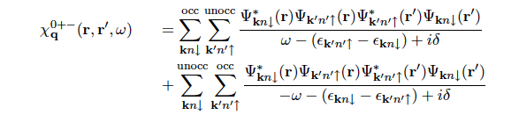
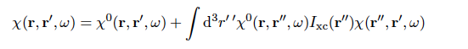
Calculations: Time-dependent DFT
Orig. U. Halle; P. Buczek ; PRB 84 1744418 (2011) ; M.Lueders re-implemented
Time dependent density functional theory: in principle exact
Non-interacting susceptibility:
Self-consistency requirement:
induced charge and magnetisation density modifies exchange-correlation potential
Exact linear response with functional derivative of exchange-correlation potential w.r.t. density
Looks like RPA, but there the approximations are ad hoc
Approximations to make tractable (‘KKR all electron’, ‘Atomic Sphere Approximation’, imaginary time with analytic continuation,,,)
BUT time-consuming, & expected to fail for e.g. cuprates
Notes:
The induced charge and magnetization densities described by the Kohn-Sham susceptibility modify the Hartree and exchange-correlation potential

Slide 29

Calculations: QSGW (Questaal)
M. van Schilfgaarde https://www.questaal.org/
Many body technique (Quasiparticle self-consistent GW approximation: QSGW)
Effective single particle Hamiltonian based on self-consistent perturbation theory (cf DFT)
Use DFT band structure + ‘rigid spin approximation’ to compute interacting susceptibility
Essentially indistinguishable results cf TD-DFT
Fast: x 100 faster for Fe ➔ full 4D susceptibility χ⁺⁻ (q,ω)
Goal:
benchmark calculation approaches
Provide ‘user service’
Interface with data analysis programs

Slide 30
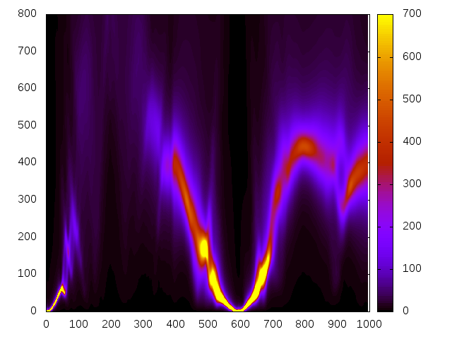
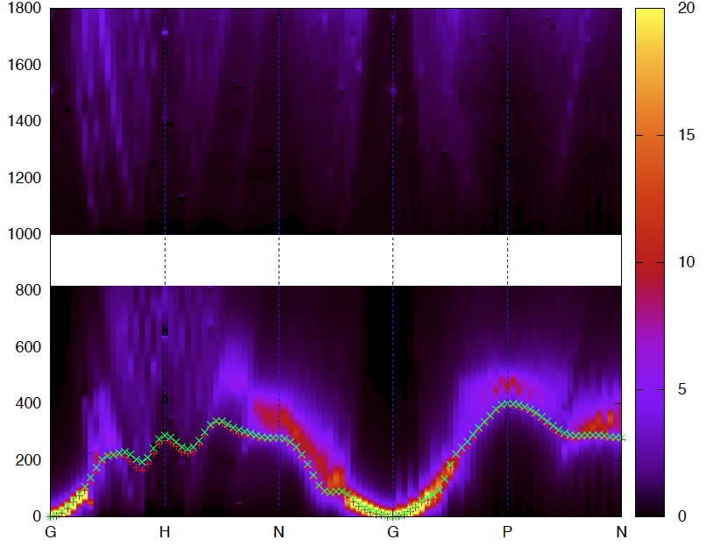
Rigid spin approximation
In Questaal
Full TD-DFT
G
H
N
G
P
N

Slide 31
Experiment: data
Broad areas of agreement:
Well-defined spin waves from Gamma point
‘Dispersion’ fine
Loss of intensity approaching H point (i.e. [1,0,0])
Areas of disagreement:
Energy scale generally stretched by ≈ 1.4
GH (i.e. [100]) damping not observed
P point (i.e. [0.5,0.5,0.5]) loss of intensity

Slide 32
Experiment: data
Broad areas of agreement:
Well-defined spin waves from Gamma point
‘Dispersion’ fine
Loss of intensity approaching H point (i.e. [1,0,0])
Areas of disagreement:
Energy scale generally stretched by ≈ 1.4
GH (i.e. [100]) damping not observed
P point (i.e. [0.5,0.5,0.5]) loss of intensity

Slide 33
Data
Log(Calculation)
Ei = 400 meV
Ei = 200 meV

Slide 34
Experiment: data
[100] direction
[110] direction
ε=125 meV
ε=125 meV
Low energy dispersion:
Experiment: D = 205 meV Å²
Calculation:

Slide 35
Our calculations:
Cao et al (PRB 97 024420 (2018):

Slide 36
Summary
Measured the spin dynamics to 0.4 eV in iron
Discrepancies with earlier data from triple axis spectrometer
No observation of intensity drop above ≈100 meV
Well defined spin waves along [100] to > 300 meV
Moderate agreement with latest calculations
TD-DFT and rigid spin approximation to kernel
BUT energy scale renormalisation and [100] direction are major differences

Slide 37
The End

Slide 38
Calculations: QSGW (Questaal)
Many body technique (Quasiparticle self-consistent GW approximation: QSGW)
Effective single particle Hamiltonian based on self-consistent perturbation theory (cf DFT)
LDA – band gaps usually wrong
LDA+U – ad hoc parameter, need not be sufficient
Approach: Non-interacting susceptibility χ₀⁺⁻ ➔ χ⁺⁻
Questaal implementation
Fast: x 100 faster for Fe ➔ full 4D susceptibility χ⁺⁻ (q,ω)
Goal:
benchmark calculation approaches
Provide ‘user service’
Interface with data analysis programs

